Slide 1
Containerized front-end development with Docker & React
Petar Ilijašić, mag. ing. comp.
Hrvoje Gazibara, mag. ing. comp.

Slide 2

O predavačima
Petar Ilijašić
Magistar inženjer računarstva (FER, 2017.)
Team leader & Software development engineer
DevOps, Software Architecture, Information Security
petar.ilijasic@avl.com

Slide 3

O predavačima
Hrvoje Gazibara
Magistar inženjer računarstva (FER, 2014.)
Team leader & Software development engineer
Full-stack development, Software architecture, Digitalization
hrvoje.gazibara@avl.com

Slide 4
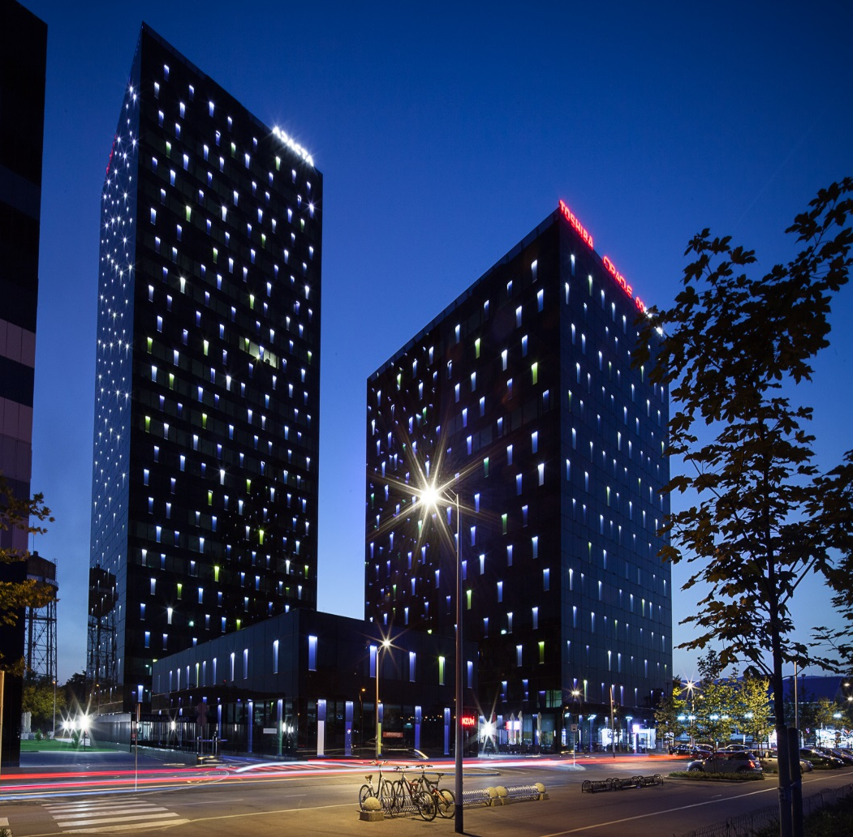
AVL-AST D.O.O. CROATIA
Najveća neovisna svjetska tvrtka za razvoj, simulaciju i ispitivanje svih vrsta pogonskih sustava
Integracija inovativnih sustava u području autoindustrije (autonomna vožnja, virtualizacija automobila…)
Glavne aktivnosti
Software development
Računalne simulacije
Technical writing
Big Data metodologija

Slide 5


Sadržaj predavanja
Docker tehnologija
Što je Docker
Koja je svrha korištenja Docker tehnologije
Kako jednostavno postaviti razvojno okruženje
Osnove tehnologije React
Osnove Reacta
Kako upogoniti React kroz Docker container
Pisanje i pokretanje testova

Slide 6
DOCKER

Slide 7
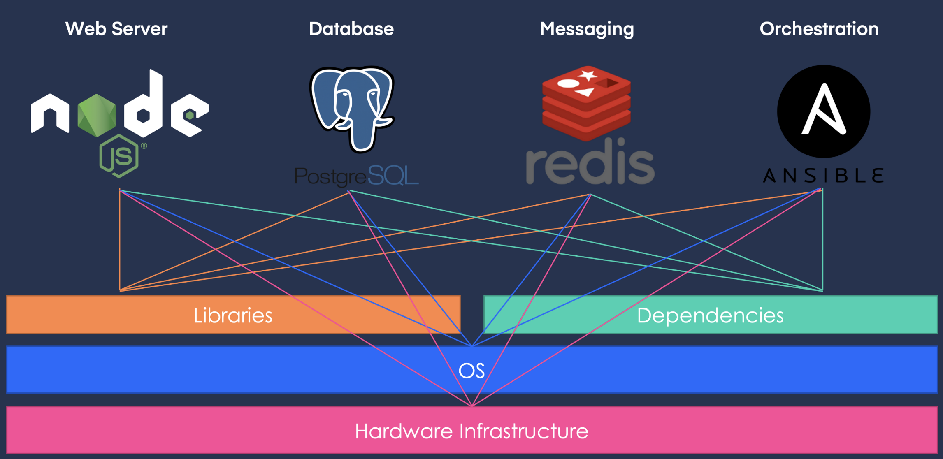

Slide 8

Što je Docker?
Alat za „pakiranje” aplikacije i potrebnih paketa u jedan Docker container
Koristan prilikom dizajniranja kompleksnih aplikacija s visokom međuzavisnosti
Olakšava library version handling
Rješava problem nadogradnje sustava sa dodatnim komponentama

Slide 10
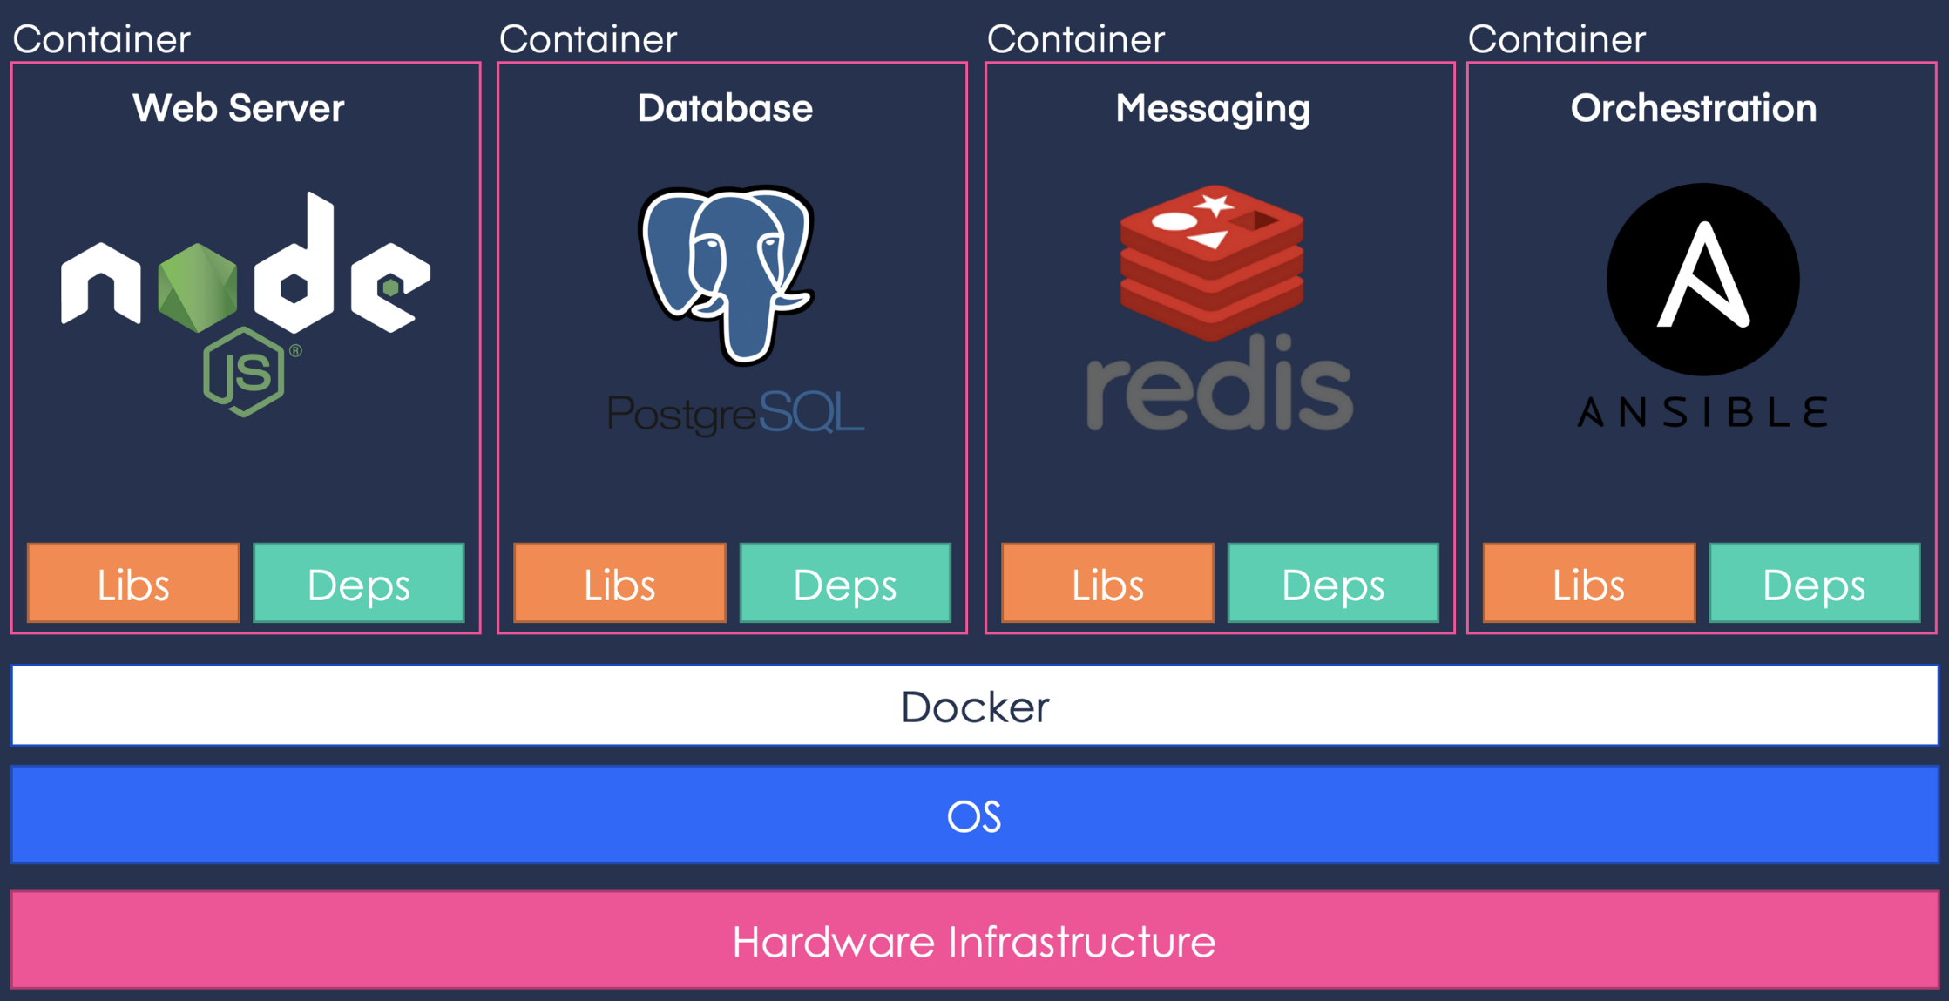

Slide 11
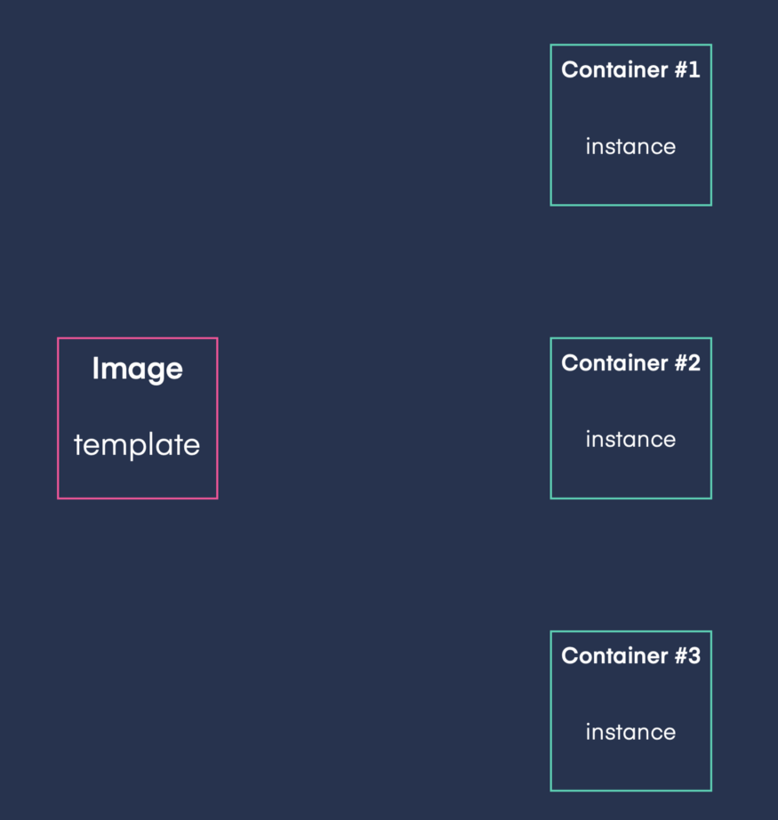
Docker image
Template aplikacije i njegovog razvojnog okruženja
Instanca Docker imagea se zove Docker container
Omogućuje pokretanje N instanci iste aplikacije
Sadrži potreban izvorni kod, konfiguracije,
environment varijable i librarije

Slide 12
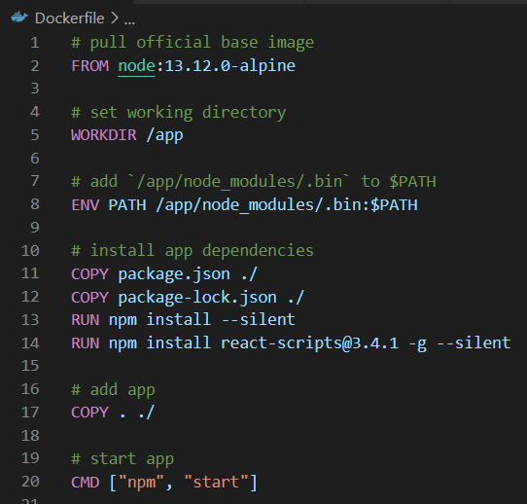
Dockerfile
Tekstualna datoteka sa skupom naredbi za kreiranje
Docker imagea
Opisuje način pokretanja Docker containera
Omogućuje prilagođavanje baznog Docker imagea za traženi use-case
ENTRYPOINT se koristi ako container koristimo
kao executable

Slide 13
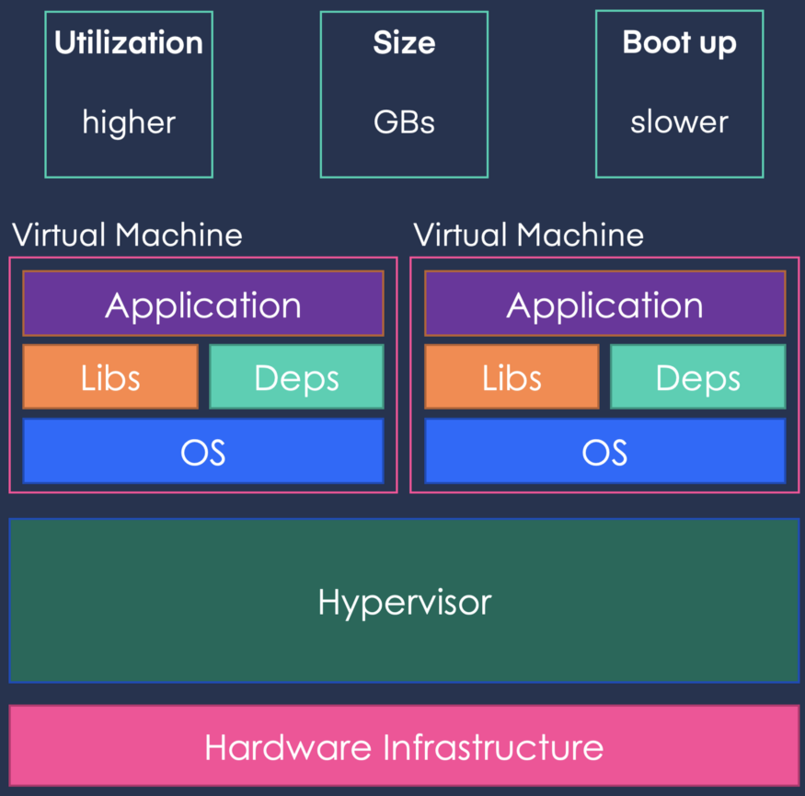
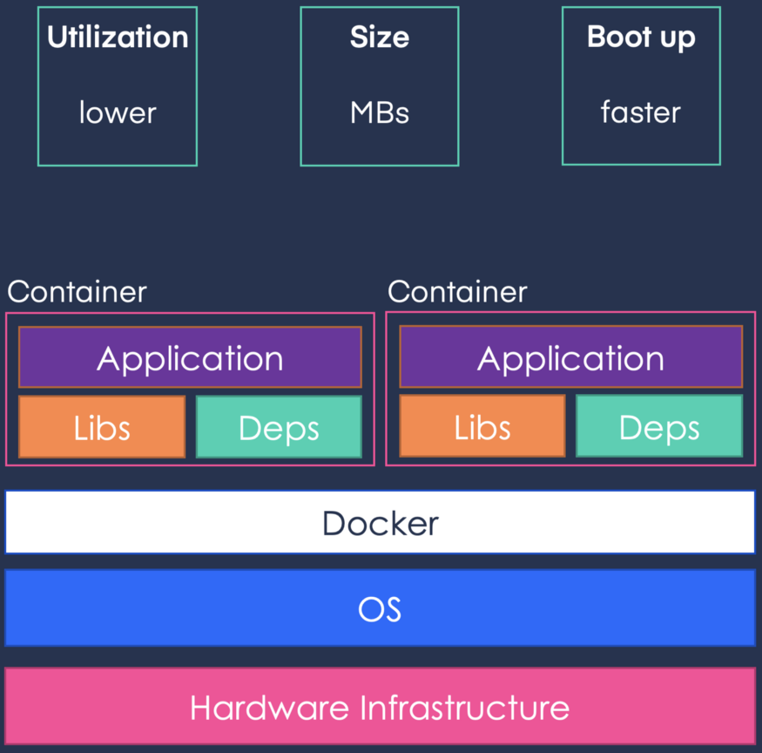
VM arhitektura vs. Docker arhitektura

Slide 14
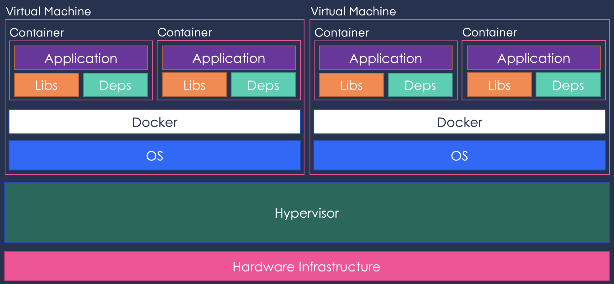
Docker-Virtual Machine arhitektura
Smanjuje se broj virtualnih strojeva, veća štednja resursa, veća brzina rada aplikacije

Slide 15
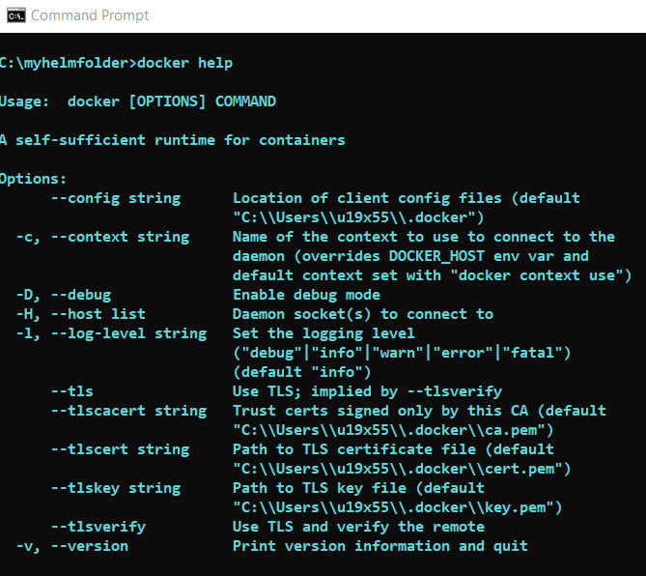
Najčešće korištene Docker naredbe
docker pull <image name:tag>
docker build [-t <name_of_image>] [-f <name_of_Dockerfile>] <path_to_Dockerfile>
docker run --name <prefered name> <image name>:<image tag>
docker images
docker ps
docker stop <container ID or name>
docker rm <container ID or name>
docker rmi <image ID or name>
docker exec –it <container ID or name> bash
docker logs <conainer ID or name>

Slide 16
DEMO

Slide 17
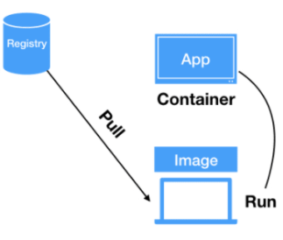
Scenarij 1: Preuzimanje Docker imagea

Slide 18
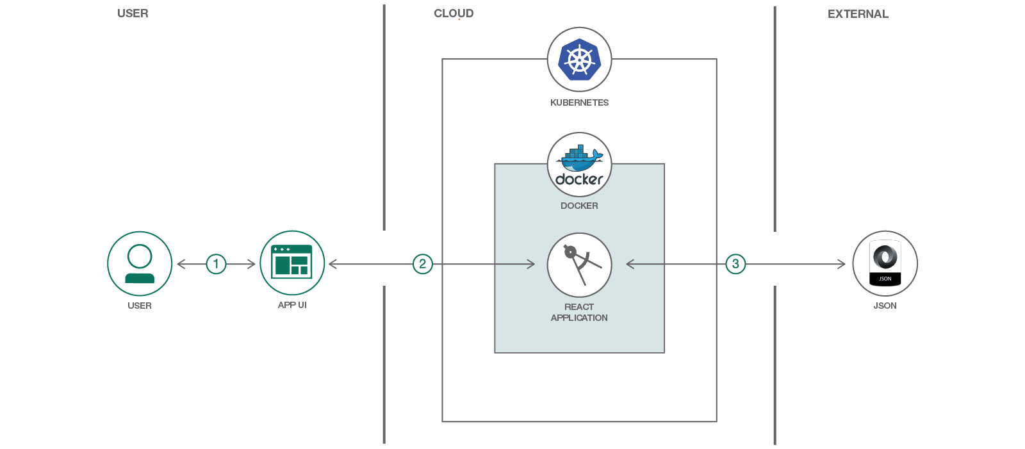
Scenarij 2: Dockerize React app

Slide 19
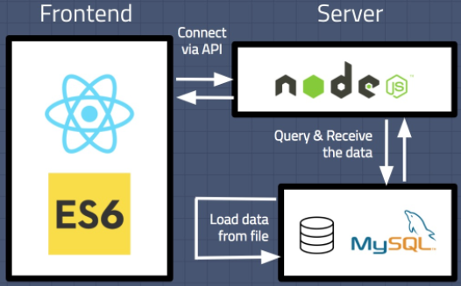
Scenarij 3: Postavljanje testnog okruženja

Slide 20
React

Slide 21
Before React: “Vanilla development”
Advantages:
Easy to learn and start
No complex/complicated environment to manage
Great for pages and apps with little DOM manipulation
Difficult to get faster than this
Disadvantages:
Larger files that contain the complete logic => more difficult to get around the code
Handle rendering and “low-level” logic by hand
More work to share common components between projects

Slide 22
React Overview
Advantages:
Abstracts rendering logic + updates only what changes
Encapsulates component development and keeps components isolated => easier re-use
Easy to extend:
Routing (single page apps)
State & data management
…
Disadvantages:
More complex development environment => more difficult to start
Lots of dependencies => large builds

Slide 23
Components
Component == class or function that splits UI into isolated entities
Use JSX to define HTML elements
Support composition and inheritance
Can accept data from other components
import Container from './Container'
class App extends React.Component {
render () {
return (
<Container>{this.props.message}</Container>
)
}
}

Slide 24
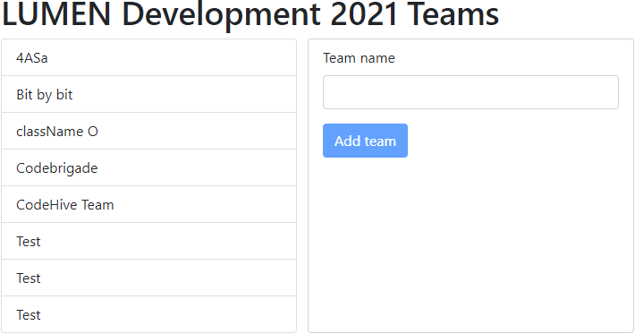
Components
Header
TeamsOverview
TeamsEditor

Slide 25
Rendering
Virtual DOM + React elements
In case of changes, React updates only what’s necessary
Supports conditional rendering and rendering lists
When defining React elements, special rules for some HTML attributes apply:
class => className
for => htmlFor
Some attributes (like style, checked, value, …) support “React syntax”

Slide 26
Events
DOM element events => React element events
Names follow camelCase convention
Functions (methods) are passed as event handlers
Be careful about binding this!
Prevent default behavior when necessary
class App extends React.Component {
handleOnClick (e) {
e.preventDefault()
}
render () {
return (
<button onClick={this.handleOnClick.bind(this)}>Click</button>
<button onClick={(e) => this.handleOnClick(e)}>Click</button>
)
}
}

Slide 27
Thinking in React
Prepare “vanilla” layout
Freeze the app
Use HTML to prepare the wireframe of your page or component.
Make sure your data loads as it should. Do not implement or test interactivity.
Remove all dependencies
Organize the flow
Prepare a self-sufficient solution that hardcodes all data dependencies.
Interactive apps move data around. Define which components holds what.
Sketch the component structure
Establish communication
Break the component into smaller sub-components for easier re-use.
Implement the inverse data flow.
Organize components
Create folders and subfolders for your components and keep each component in its file.

Slide 28
Testing
Use testing-library/react
General practice is to use the AAA pattern
Arrange
Act
Assert
Can set up test runner with a watcher to re-run the tests automatically when any test file changes
Demo #3: React components

Slide 29
Running in Docker
See demo

Slide 30
Toolchain
Application Creation
Component Development
Testing
Use “Create React App” to easily set up your React application.
Single command to prepare all dependencies and the application folder structure:
$ npx create-react-app my-app
As your apps grow, you have more and more components and it becomes more difficult to track component states.
Check out “Storybook”, which helps you develop React components in isolation.
Work with “Jest” to set up unit tests for your components.
Jest is a test runner that allows you to access DOM.

Slide 31

UI component libraries
MATERIAL-UI

